Slide 1
The 1848 Revolutions:
Italian city states
“The Springtime of the Peoples”

Slide 2
Key concepts
Nationalism: the pursuit-through argument or other activity-of a set of rights for the self-defined members of the nation, including, at a minimum, territorial autonomy or sovereignty:
  (1) defines the territorial boundaries that the nation has a right to control and;
  (2) the membership boundaries of the population that makes up the nation-the group that deserves this territorial control and that is entitled to the supreme loyalty.¹
Liberalism: the group which wishes to alter existing institutions with the view of increasing popular power.
Conservatism: adheres to tradition, hierarchy; preserves religious institutions. The monarch, the aristocracy, and the military retain most of the power.²
coup d'etat: the forcible removal of an existing government from power through violence.
Principle of Legitimacy: idea that after the Napoleonic wars, peace could best be reestablished in Europe by restoring legitimate monarchs who would preserve traditional
Notes:
Haas, Ernst. 1986. "What is Nationalism and Why Should We Study It?" International Organization 40(3): 707-44.
James Fitzjames Stephen, "Liberalism," Cornhill Magazine V (1862): 72-73. See also Leonard Hobhouse, Democracy and Reaction (London: Unwin, 1904), 166.

Slide 3
Significant Causes
Causes of the 1848 Italian Revolution
The following led Italian revolutionaries to stage revolution in order to drive out the Austrians:
  1. The conservative leadership of Italian monarchs (and later the Austrian Empire)
  2. The redrawing of Italian boundaries by the Congress of Vienna
  3. Nationalism: The desire for independence from foreign rule (Austrian Empire)

Slide 4
The Springtime of the Peoples
The European Revolutions of 1848
A series of political upheavals throughout the European continent
After the French Revolution and Napoleon, another rebellion in France takes place in 1830
  As news spread, revolutions broke out in other parts of Italy, Prussia, Austria and the German Confederation – driven by nationalism (not liberalism like French Revolution)
Problem: internal divisions based on nationalism and on a radical/liberal split soon weakened the revolutionaries
By 1852 conservatives had taken advantage of the weaknesses and regained power.
  In France, Napoleon Bonaparte’s nephew, Louis Napoleon took power in a coup d'etat
While the immediate political effects of the revolutions were a failure, the long-term impacts of the events were far-reaching

Slide 5
The Springtime of the Peoples
The Italian Wars of Independence
France, Spain, the Holy Roman Empire, and various states in the Italian Peninsula fought intermittently from 1494 to 1559
  The Italian Wars began in 1494, when the armies of France invaded Italy with the goal of conquering Naples.
The situation regarding political legitimacy in Europe at the time was very chaotic
Rulers often claimed rightful rule over territories through tenuous links.
  When the French invaded Italy in 1494, for example, King Charles VIII claimed the right to rule Naples through his grandfather’s brother-in-law.
The early years of the Italian Wars brought multiple, conflicting views of legitimacy into contact with each other.³
Notes:
3. Charles W. C. Oman, A History of the Art of War in the Sixteenth Century (London: Methuen & Co., 1937), 31-32.

Slide 6
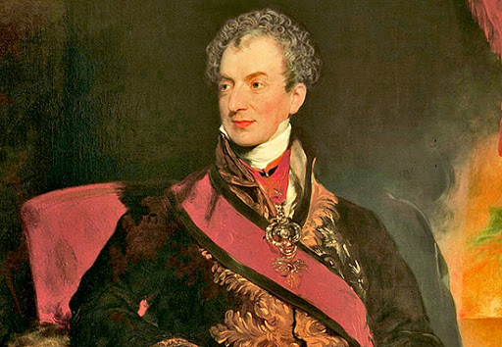
The age of Metternich
Klemens von Metternich
Led the Congress of Vienna
Dedicated conservative: goal was to maintain the balance of power by resisting Russian expansion in Central Europe and Ottoman Empire
  Only proper form of government was an absolute monarchy:
    Liberalism = legalized revolution
    Championed the principle of legitimacy
    Wanted to prevent the breakup of the Austrian Empire by crushing nationalist revolts in Austrian north Italy and German states = successful
    Carlsbad Decrees of 1819: used strict censorship of education, press and speech to repress revolutionary and liberal concepts.
      Known as the man who prevented Austria and the rest of central Europe from "developing along normal liberal and constitutional lines.”⁴
Fig. 4: Metternich was the Foreign Minister and Chancellor of State for the Austrian Empire. He controlled the Habsburg Monarchy's foreign policy and influenced European politics for four decades (1809-1848).
Notes:
4. Sked, Alan (1983). "Metternich". History Today. 33 (6).
Fig. 4: Sir Thomas Lawrence, Clemens Wenzel Lothar Fürst Metternich.

Slide 7
Cause #1: conservative domination
Conservatism
In 1790 Edmund Burke wrote Reflections on the Revolution in France in reaction to the French Revolution
  Believed that society was a contract
  Advised against the violent overthrow of a government by revolution
Favored obedience to political authority
Believed that organized religion was crucial to social order
Hated revolutionary upheavals
Against representative governments:
  Community takes precedence over individual rights
  Tradition remained the best guide for order

Slide 8
the congress of Vienna
The Congress of Vienna
Desire to contain revolution and revolutionary forces
  The immediate response to the defeat of Napoleon after the French Revolution and Napoleonic Wars
Four major enemies came together: GB, Austria, Prussia, and Russia to defeat France and ensure peace
Led by Metternich who believed it was necessary to restore legitimate monarchs who would preserve traditional institutions
  Believed it was the Congress’ right to intervene in any revolution

Slide 9
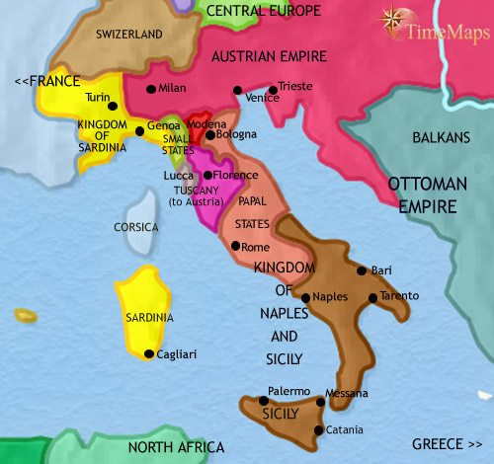
Cause #2: new European borders
Italian-City States in 1848
Italy was not a unified country, and was divided into many states
To make sure no one power dominated Europe, the Congress of Vienna redrew the map:
  This included new boundaries in Italy
    The Congress created nine new states in Italy, including Piedmont (part of the Kingdom of Sardinia)
  Congress of Vienna gives Northern Italy to the Austrian Empire
When revolts broke out in Italy, Metternich viewed it as a threat to Austrian domination of the peninsula.
Fig. 2: Italian city-states, 1837 after the Congress of Vienna redraws the map of Europe.
Notes:
Fig. 2: Kent, Alexander. "Italy 1837 CE." Edited by Peter Britton and Jonny Britton. Time Maps. Accessed March 25, 2020. https://www.timemaps.com/history/italy-1837ad/.

Slide 10
The Voice of Conservatism: Metternich
Source: Memoires of Prince Metternich, Klemens von Metternich, 1819.
We are convinced that society can no longer be saved without strong and vigorous resolutions on the part of the Governments still free in their opinions and actions. We are also convinced that this may yet be, if the Governments face the truth, if they free themselves from all illusion, if they join their ranks and take their stand on a line of correct, unambiguous, and frankly announced principles. By this course the monarchs will fulfil the duties imposed upon them by Him, who, by entrusting them with power, has charged them to watch over the maintenance of justice, and the rights of all, to avoid the paths of error, and tread firmly in the way of truth.
Union between the monarchs is the basis of the policy which must now be followed to save society from total ruin.
In short, let the great monarchs strengthen their union, and prove to the world that if it exists, it is beneficent, and ensures the political peace of Europe: that it is powerful only for the maintenance of tranquility at a time when so many attacks are directed against it; that the principles which they profess are paternal and protective, menacing only the disturbers of public tranquility.⁵
1. Who wrote this? | 2. Who is the audience? | 3. When was this source written? What was happening at that time? | 4. Why was this source written?
5. Based on the document, what problems existed at the time?
Notes:
5. Excerpt from Memoires of Prince Metternich, Volume 3, edited by Prince Richard Metternich and translated by Mrs. Alexander Napier (New York: Charles Scribner’s Sons, 1881), pp. 455, 462–463, 465–467, 469–471, 475.

Slide 11
The springtime of the peoples
Italian City-States in 1848
Liberal friendly events start in Rome, this sparks rebellions in other city-states:
  Sicily: the people began to demand a Provisional Government
    Goal: want separate from the government of the mainland
    Forced the king to allow a provisional government to be constituted
    Revolts spread to Salerno and Naples
Most states still were under a conservative rule:
  Northern Italians could not enjoy these freedoms
    The Austrian Empire tightened their grip on the people by further oppressing them with harsher taxes

Slide 12
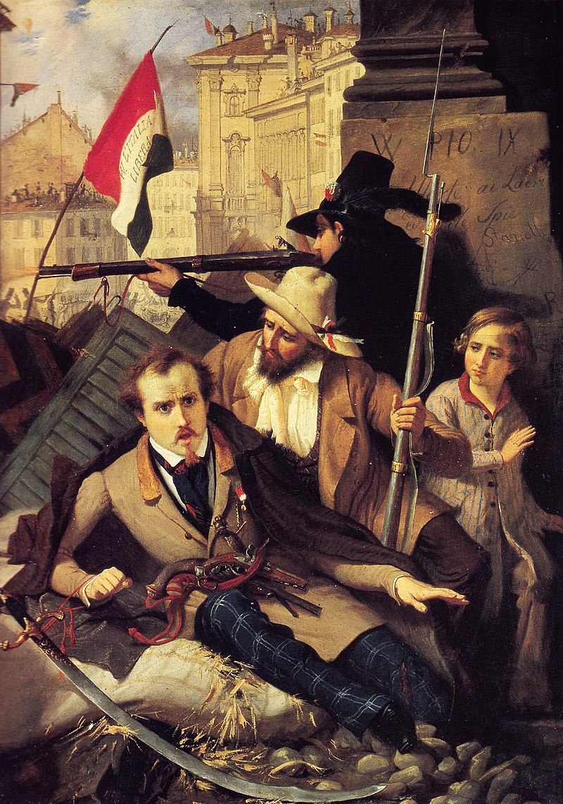
The springtime of the peoples
Italian City-States in 1848
Patriotic Italians staged a ‘tobacco strike’ to prevent the tax revenue going to Austria.
Forced Italian leaders to establish liberal constitutions
  In Piedmont-Sardinia, King Charles Albert was one who voluntarily granted a new constitution to his people.
  In March, Austrian troops were forced out of Milan and Venice.
Charles tried to drive the Austrians out of north Italy
  Defeated in 1848 and again in 1849 = abdicated
Revolutions elsewhere were suppressed, including one in Rome
Fig. 3: Artist Baldassare Verazzi paints a scene from the Five Days of Milan – the first major event of the Revolutionary War in Italy.
Notes:
Fig 3: Verazzi, Baldassare, un épisode des cinq journées de Milan en 1848, Museo del Risorgiment, Milan. 1886.

Slide 13
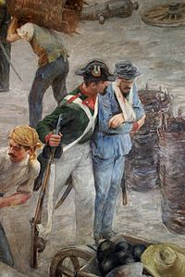
Cause #3: Rise of nationalism
Nationalism
A conservative ruling class resisted liberal political reform and clung tight to the ancient traditions of absolute monarchy and landowner/church/feudal power
Another dimension was provided by the rise in nationalism amongst educated Europeans wishing for independence from imperial control.
The timing of the revolutions is to be found in socio-economic causes.
Fig 1: Italian soldiers in defense of Venice against the Austrians, by Vittorio Bressanin
Notes:
Fig. 1: Bressanin, Vittorio Emanuele, 1860.

Slide 14

Carbonari
“The Charcoal Burners”
An informal network of secret revolutionary societies active in Italy from about 1800 to 1831
Goal = resist Austrian occupation of Italy based on nationalist views
Had a patriotic and liberal basis
  Inspired by the principles of the French Revolution regarding liberty, equality and fraternity.
  Hostile towards the Catholic Church
Lacked a clear immediate political agenda
The chief purpose was to defeat tyranny and to establish constitutional government
Crushed by more reactionary European governments that had emerged after the fall of Napoleon.⁶
Fig 6: The flag of the Carbonari; an ex-Carbonaro, Giuseppe Mazzini, would go on to become a prominent leader in the Risorgimento, the political movement that finally led to Italian unification.
Notes:
6. Heckethorn, Charles William. The Secret Societies of All Ages and Countries, Volume 2, 1875.
Fig. 6: Neville, Katherine. Secret Societies. 12 January 2013.

Slide 15
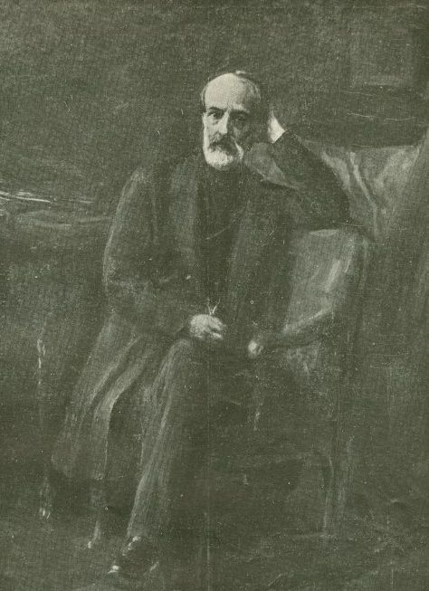
Risorgimento
Italian Unification
Led by Giuseppe Mazzini – founded Young Italy, a nationalist organization in 1831 to create a united Italy
  Urged Italians to dedicate their lives to their Italian nation
  Called for an end to foreign rule
  His efforts helped bring about the independent and unified Italy in place of the several separate states
  Helped define the modern European movement for popular democracy in a republican state.
Cristina Belgioioso: wealthy aristocrat who worked to bring about Italian unification
  Targeted by Austrian authorities
  Fled to Paris
Fig. 7 Mazzini helped define the modern European movement for popular democracy in a republican state.
Notes:
Fig. 7: Italian unification politician Giuseppe Mazzini, New York Public Library Archives.

Slide 16
Risorgimento
“Fathers of the Fatherland”
Along with Mazzini, the following are important contributors to the unification of Italy after 1848:
Giuseppe Garibaldi: an Italian general, patriot, and republican
  Follower of Mazzini’s
  Embraced the republican nationalism of the Young Italy movement⁷
  Leader of the Redshirts: a group of volunteers who fought for Italian freedom
Count of Cavour: The first Prime Minister of Italy
  Died after only three months in office
  Did not live to see Rome added to the new Italian nation
Victor Emmanuel II of Italy: The first king of a united Italy since the 6th century, a title he held until his death in 1878.
Notes:
7. Lucy Riall (2008). Garibaldi: Invention of a Hero. Yale UP. p. 1.

Slide 17
The Voice of Italian nationalism: Giuseppe Mazzini and young Italy
Source: Duties Towards Your Country, Giuseppe Mazzini, 1858.
Oh, my brothers, love your Country! Our country is our Home, a house God has given us, placing therein a numerous family that loves us, and whom we love; a family with whom we sympathize more readily and whom we understand more quickly than we do others; and which, from its being centred round a given spot, and from the homogeneous nature of its elements, is adapted to a special branch of activity. Our Country is our common workshop, whence the products of our activity are sent forth for the benefit of the whole world; wherein the tools and implements of labour we can most usefully employ are gathered together; nor may we reject them without disobeying the plan of the Almighty, and diminishing our own strength.⁸
1. Who wrote this? | 2. Who is the audience? | 3. When was this source written? What was happening at that time? | 4. Why was this source written?
5. Based on the document, what problems existed at the time?
Notes:
8. Excerpt from, An Essay On the Duties of Man Addressed to Workingmen. Chapter V: Duties Towards Your Country. 57-63. New York: Funk & Wagnalls, 1898. Hanover Historical Texts Project.

Slide 18
The Italian hamlet
King Charles Albert
The King of northern Italian state, Piedmont-Sardinia from 1831 to 1849
  Only native monarch in Italian States
He adopted the idea of a federal Italy, led by the Pope and freed from the House of Habsburg in 1848
Liberal sovereign:⁹
  Albertine Statute: the first Italian constitution, which became the constitution of unified Italy
Led forces against the Imperial Austrian army in the First Italian War of Independence (1848–1849):
  His invasion of Lombardy proved unsuccessful
  By 1849 the Austrians had reestablished complete control over Lombardy and Venetia.
  Counterrevolutionary forces also defeated Italians
  French forces helped Pope Pius IX to regain control of Rome
Notes:
9. Denis Mack Smith, Il Risorgimento italiano, Roma-Bari, Laterza, 2011, p. 205.

Slide 19

Propaganda
Young Italy:
Political movement for Italian youth (under age 40) founded by Mazzini
Goal: to create a united Italian republic through promoting a general insurrection in the Italian reactionary states and in the lands occupied by the Austrian Empire
Attracted most of Italian population (except nobility and clergy) who were seeking economic prosperity, wider participation in government and a common identity
Easily spread throughout Italy and other nations across Europe:
  1. Speeches – Mazzini held rallies to gather support
  2. Redshirts – volunteers who followed the charismatic Garibaldi to battle
  3. Popular uprisings – believed this would create a unified Italy – he was right
The slogan that defined the movement's aim was "Union, Strength, and Liberty"
  The phrase could be found in the tricolor Italian flag, which represented the country's unity
Fig. 9: il Tricolore, inspired by the flag of France born during the French Revolution. The green represents hope, white represents faith, and red represents love.
Notes:
Fig. 9: Country Flags. “Italy.” 27 March 2020.

Slide 20
The failures of 1848
Why did the Revolution Fail?
Throughout Europe in 1848, popular revolts had initiated revolutionary upheavals that had led to the formation of liberal constitutions and liberal governments.
Two reasons why this revolution failed:
  1. unity of the revolutionaries made it possible, but divisions shattered their ranks
    Radicals pushed for universal male suffrage
      Result = liberals ended up supporting the ruling class to secure property rights. This led to established governments taking control back
  2. Failed to give the same rights to minorities; for example Jews were not granted the same rights as Catholics in Italy.

Slide 21
The failures of 1848
Why did the Revolution Fail?
Even though the Revolution of 1848 failed, it created a foundation for the Second Italian War of Independence in 1859, which played a crucial part in the process of Italian unification.
Long lasting effects of the First Italian War of Independence that go on to ultimately lead to a successful unification:
  1. the Albertine Statue
  2. Strong sense of nationalism
  3. Military Revolution

Slide 22
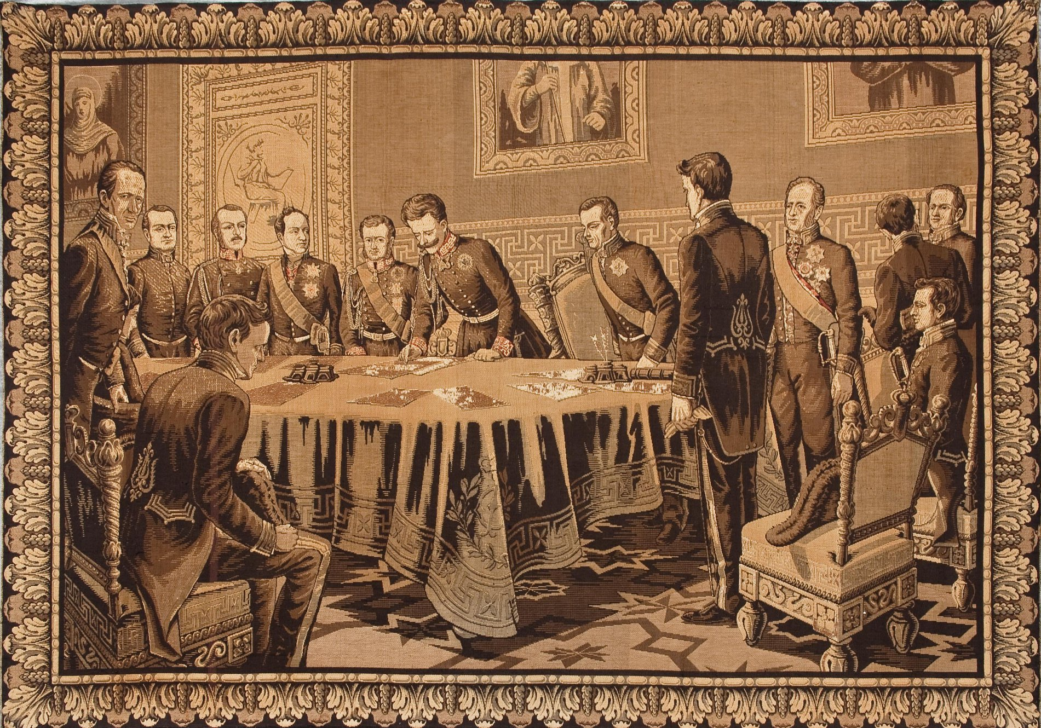
Effect #1: the Albertine statute
The Italian Constitution: Albertine Statue
The constitution that Charles Albert of Sardinia approved on 4 March 1848.
Becomes the constitution of the unified Kingdom of Italy and remained in force, (with changes) until 1948
Established Catholicism as the sole state religion
Grants freedom of religion for all existing forms of worship
Established a representative monarchy, with a hereditary crown
Legislative power was exercised collectively by the King, the Senate and the Chamber of Deputies.
Executive power was entrusted in the King, who was declared to be "sacred and inviolable.”¹⁰
Fig. 8: King Charles Albert signing the Albertine Statute, the only constitution to survive the repression that followed the First War of Independence (1848–1849). The Statute remained the basis of the legal system even after Italian unification was achieved in 1861 until Benito Mussolini gained power in 1925.
Notes:
10. Mack Smith, Denis (1997). Modern Italy: A Political History. Yale University Press.
Fig. 8: Author unknown, Charles Albert, King of Sardinia signing the Statute (1848).

Slide 23
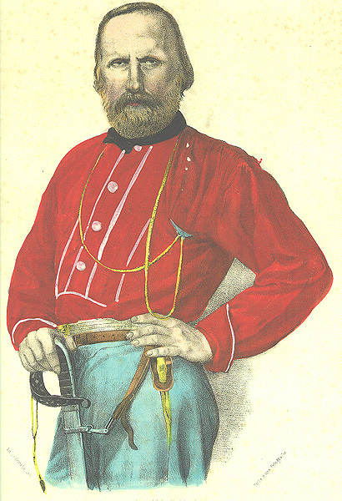
Effect #2: rise in nationalism
Risorgimento: Italian "Resurgence”
The political and social movement in the 19th century that consolidated different states of the Italian peninsula into the single state of the Kingdom of Italy in 1861
  Led by the “Fathers of the Fatherland”
  Began with the revolutions of 1848 that contested the outcome of the Congress of Vienna
  Process is completed when Rome is established as the capital of the Kingdom of Italy
Emphasizes the romantic, nationalist and patriotic ideals of an Italian renaissance through the conquest of a unified political identity.¹²
Fig. 9: Giuseppe Garibaldi also served as a global exemplar of mid-19th century revolutionary nationalism and liberalism.¹¹
Notes:
11. Salvadori, Massimo L., Enciclopedia dei ragazzi Treccani (2005) alla voce "Italia, storia di.’’
12.Hibbert, Christopher. Garibaldi and his Enemies: The Clash of Arms and Personalities in the Making of Italy. Boston: Little, Brown and Company, 1966.
Fig. 9: de Polnay, Peter. Garibaldi: The Legend and the Man. London: Hollis & Carter, 1960.

Slide 24
Effect #3: Military advancements
Military Revolution Theory
Theorized by Michael Roberts, an English historian specializing in the early modern period.
  Argued that changes in military strategy and tactics during the 16th and 17th centuries resulted in significant lasting changes in governments and society.¹³
  Caused by introduction of portable firearms
  Linked military technology with larger historical consequences
    Argued that innovations in tactics, drill and doctrine maximized the utility of firearms¹⁴
      This led for more trained troops and standing armies
        Result = armies grew much larger and more expensive
    These changes in turn had major political consequences in the level of administrative support and the supply of money, men and provisions, producing new financial demands and the creation of new governmental institutions.¹⁵
Notes:
13. Geoffrey Parker. 1996. The Military Revolution: Military Innovation and the Rise of the West, 1500-1800. Cambridge University Press.
14. Jeremy Black, "A Military Revolution? A 1660–1792 Perspective," pp. 95–115, in Clifford J. Rogers, The Military Revolution Debate: Readings on the Military Transformation of Early Modern Europe (Boulder: Westview Press, 1995); and Michael Duffy, The Military Revolution and the State, 1500–1800 ([Exeter]: University of Exeter, 1980).
15. Jacob, F. & Visoni-Alonzo, G., The Military Revolution in Early Modern Europe, a Revision, (2016).

Slide 25
Effect #3: Military advancements
Military Revolution Theory
The Italian Wars served as the proving grounds for the military changes
They existed within a chaotic political situation and made nobles reassess their masculinity in the light of new methods of warfare.
The Italians reconstructed many older fortifications:
  This style of fortress provided multiple angles of fire against attacking troops
  Relied on lower, thicker walls that were less susceptible to artillery fire than tall, thin, medieval walls.¹⁶
Fortifications allowed for improvements in firearms and cannons
Notes:
16. Simon Pepper, “The Face of the Siege: Fortification, Tactics and Strategy in the Early Italian Wars,” In Italy and the European Powers: The Impact of War, 1500-1530, ed. Christine Shaw (Boston: Brill, 2006), 33-38.

Slide 26
Timeline: 1848
Key Events in 1848:
January: Revolt in Palermo, Sicily
February: Abdication of Louis Philippe and proclamation of the Second Republic in France
March: Introduction of universal manhood suffrage and the 'right to work' in France resignation of Metternich. Violence in Berlin (see image opposite) War between Piedmont and Austria.
May: First meeting of the Frankfurt Parliament
June: Meeting of Pan-Slav Congress in Prague. Cavaignac suppresses insurrection in Paris. Austrian general Windischgratz bombards and captures Prague
July: Radetzky defeats Piedmontese at Custoza. Meeting of Constituent Assembly in Vienna
October: Windischgratz occupies Vienna
November: Pope Pius IX abandons Rome
December: Louis Napoleon is elected President of the French Republic

Slide 27
Timeline: 1849
Key Events in 1849:
February: Establishment of the Roman Republic by Mazzini and Garibaldi
March: Dissolution of the Austrian Constituent Assembly. Defeat of Piedmontese at Novara
April: Friedrich Wilhelm IV refuses the offer of the German Crown
July: Suppression of the Roman Republic by French troops
August: Hungarian rebels surrender to Austrian and Russian troops

Slide 28
quiz
1. Explain Metternich’s principle of legitimacy.
2. What were the chief ideas associated with the ideology of conservatism, and how were ideas put into practice in the first half of the 19th century?
3. What were the chief ideas associated with the ideology of liberalism and nationalism, and how were these ideas put into practice in the first half of the 19th century?
4. What role did the Congress of Vienna play in shaping Italian nationalism?
5. Was Italy successful in their attempts at unification? Explain why or why not.

Slide 29
bibliography
Author unknown, 1848. Charles Albert, King of Sardinia signing the Statute.
Black, Jeremy. "A Military Revolution? A 1660–1792 Perspective.” 1995. pp. 95–115, in Clifford J. Rogers, The Military Revolution Debate: Readings on the Military Transformation of Early Modern Europe (Boulder: Westview Press); and Michael Duffy, The Military Revolution and the State, 1500–1800 ([Exeter]: University of Exeter, 1980).
Country Flags. “Italy.” 27 March 2020.
de Polnay, Peter. 1960. Garibaldi: The Legend and the Man. London: Hollis & Carter.
Haas, Ernst. 1986. "What is Nationalism and Why Should We Study It?" International Organization 40(3): 707-44.
Hibbert, Christopher. 1966. Garibaldi and his Enemies: The Clash of Arms and Personalities in the Making of Italy. Boston: Little, Brown and Company.
Kent, Alexander. "Italy 1837 CE." Edited by Peter Britton and Jonny Britton. Time Maps. Accessed March 25, 2020. https://www.timemaps.com/history/italy-1837ad/.
Mack Smith, Denis. 1997. Modern Italy: A Political History. Yale University Press.
Metternich, Richard, translated by Napier, Alexander. New York: Charles Scribner’s Sons, 1881. Memoires of Prince Metternich, Volume 3, edited by , pp. 455, 462–463, 465–467, 469–471, 475.
Oman, Charles W. C. A History of the Art of War in the Sixteenth Century (London: Methuen & Co., 1937), 31-32.
Parker, Geoffrey. 1996. The Military Revolution: Military Innovation and the Rise of the West, 1500-1800. Cambridge University Press.
Pepper, Simon. 2006. “The Face of the Siege: Fortification, Tactics and Strategy in the Early Italian Wars,” In Italy and the European Powers: The Impact of War, 1500-1530, ed. Christine Shaw (Boston: Brill), 33-38.
Salvadori, Massimo L., Enciclopedia dei ragazzi Treccani (2005) alla voce "Italia, storia di.’’
Sir Thomas Lawrence, N/A. Clemens Wenzel Lothar Fürst Metternich.
Sked, Alan. 1983. "Metternich". History Today. 33 (6).
Smith, Denis Mack. 2011. Il Risorgimento italiano, Roma-Bari, Laterza, p. 205.
Stephen, James Fitzjames. 1904. "Liberalism," Cornhill Magazine V (1862): 72-73. See also Leonard Hobhouse, Democracy and Reaction,166.
Visoni-Alonzo, G. 2016. The Military Revolution in Early Modern Europe, a Revision.

